Slide 1
Machine Learning
Gradient Descent Algorithm
Linear Regression
Non-Linear Regression
Logistic Regression
Decision Trees
Regression Trees
Classification Trees
Model complexity and ensemble models
Clustering Algorithms
K-Means
DB-Scan
Mean Shift
GMM
Support Vector Machine
Deep Learning
MLP
CNN
VAE
GAN
Others
Naïve Bayes
Hierarchical clustering
Datasets
Breast Cancer Wisconsin
MIMIC-III
Framingham Heart Study
Alzheimer’s Disease Neuroimaging Initiative
Drug discovery
Microbiome

Slide 2
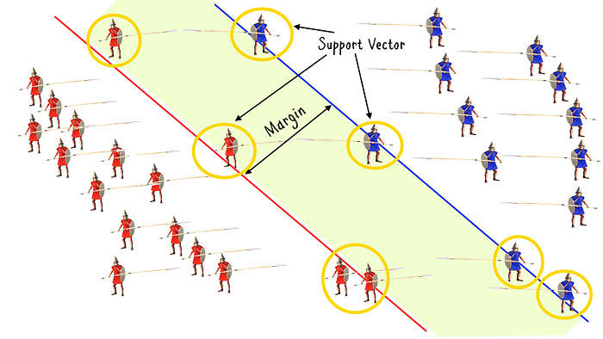
C8 – SVM
my humble ML course

Slide 3
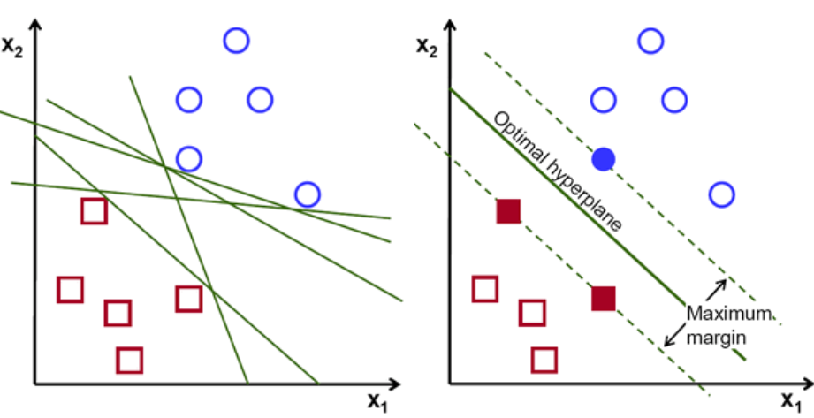
my humble ML course
Support Vector Machine
GOAL: Find the optimal hyperplane that separates data points into different classes
HOW:
Maximize the margin between the classes.

Slide 4
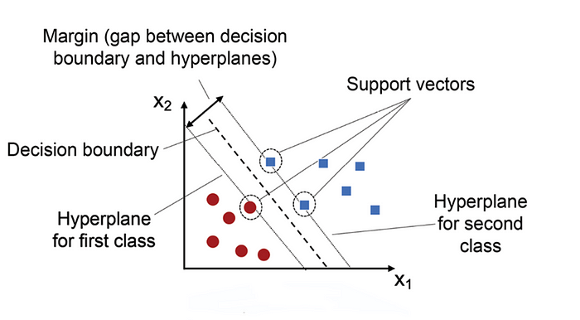
my humble ML course
Hyperplane
HYPERPLANE: Decision boundary that separates data points into different classes in a high-dimensional space.
Data points on one side of the hyperplane are classified as belonging to one class, while data points on the other side of the hyperplane are classified as belonging to another class.

Slide 5
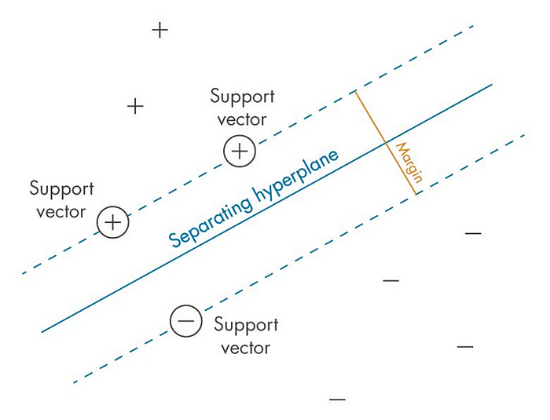
my humble ML course
Margin
MARGIN: distance between the decision boundary (hyperplane) and the closest data points from each class.
The goal of SVMs is to maximize this margin while minimizing classification errors.
A larger margin indicates a greater degree of confidence in the classification, as it means that there is a larger gap between the decision boundary and the closest data points from each class.
The margin is a measure of how well-separated the classes are in feature space.

Slide 6
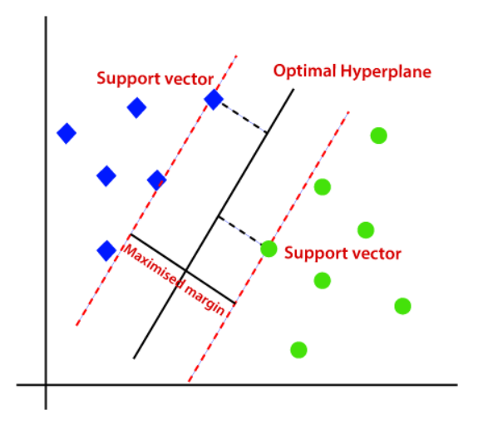
my humble ML course
Support Vectors
They are the data points that lie closest to the decision boundary (hyperplane) in a Support Vector Machine (SVM).
These data points are important because they determine the position and orientation of the hyperplane, and thus have a significant impact on the classification accuracy of the SVM.
In fact, SVMs are named after these support vectors because they “support” or define the decision boundary.

Slide 7
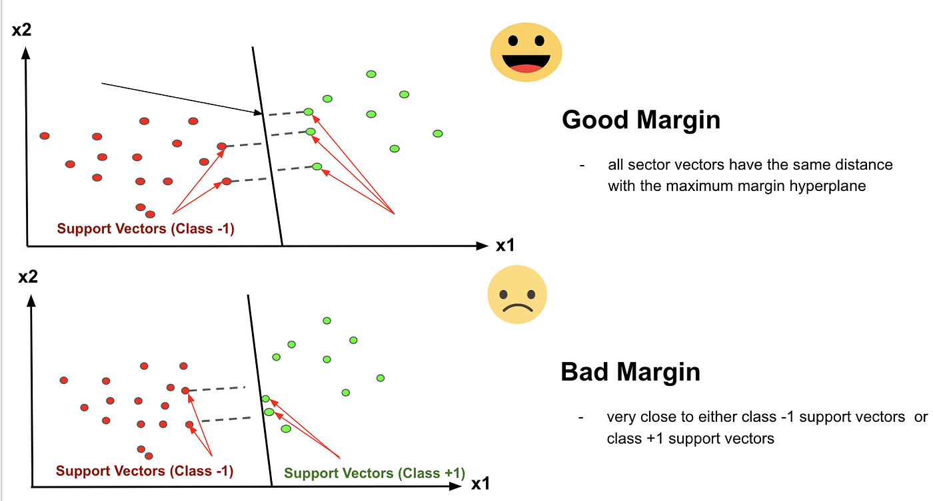
my humble ML course

Slide 8
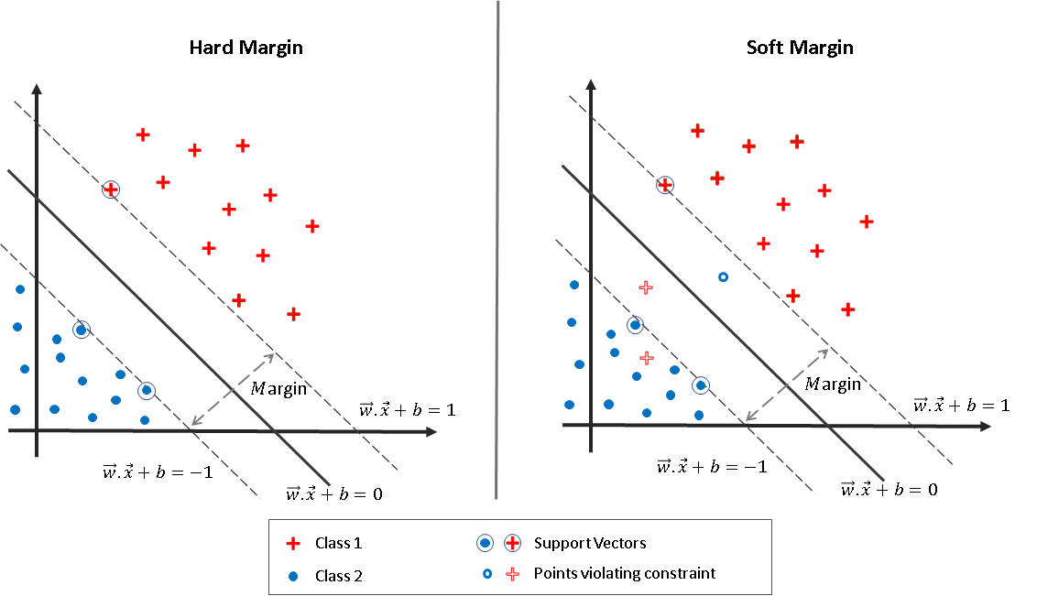
my humble ML course

Slide 9
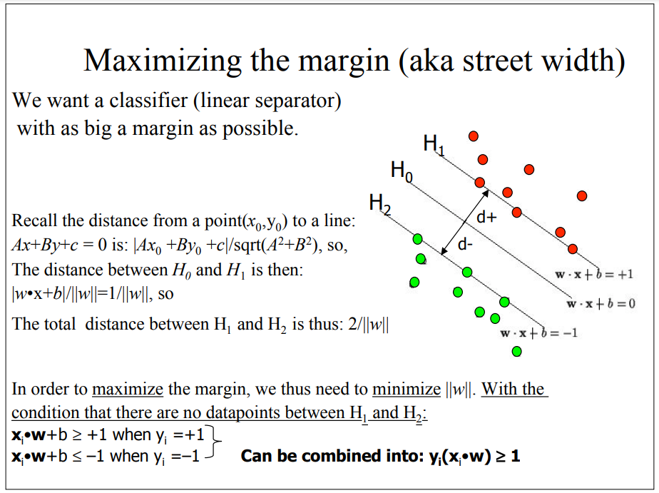
my humble ML course

Slide 10
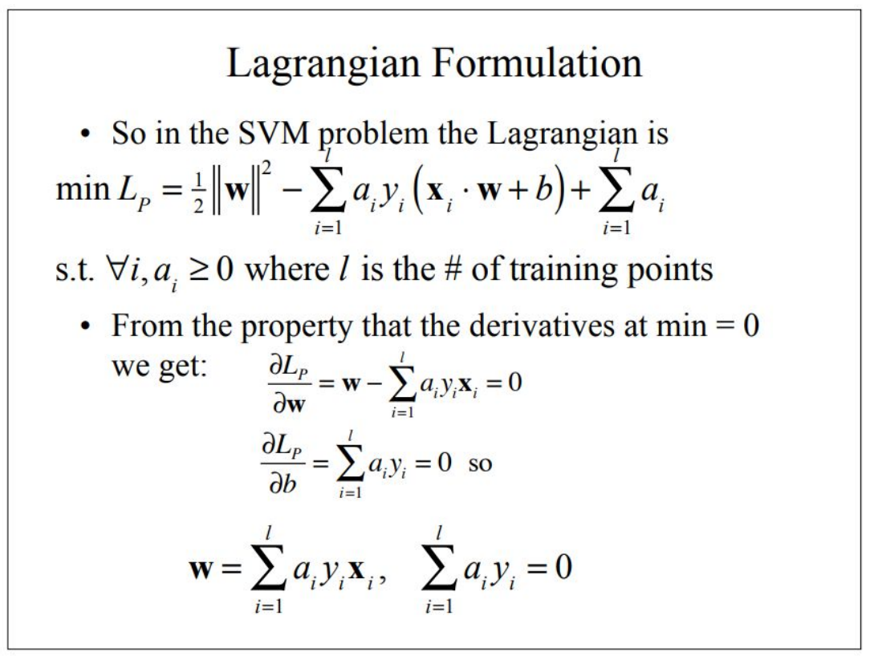
my humble ML course

Slide 11
my humble ML course

Slide 12
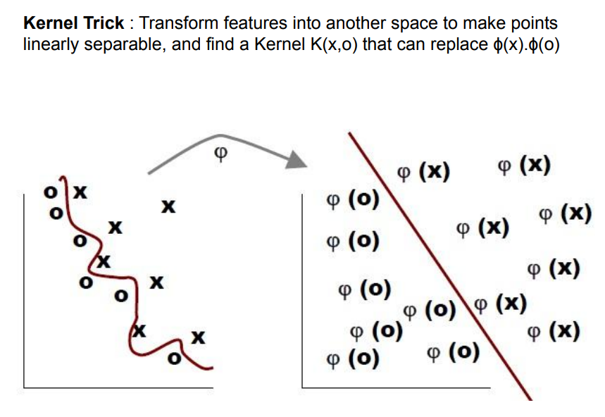
my humble ML course

Slide 13
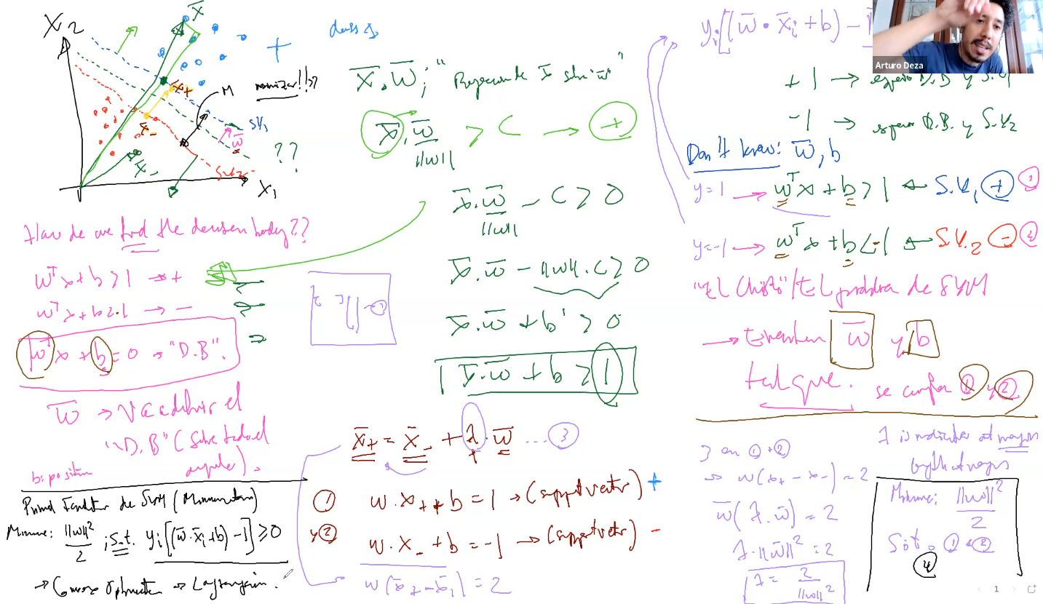
my humble ML course

Slide 14
my humble ML course
Bibliography
https://medium.com/low-code-for-advanced-data-science/support-vector-machines-svm-an-intuitive-explanation-b084d6238106
https://kawsar34.medium.com/machine-learning-quiz-03-support-vector-machine-c40cc80279a5
https://towardsdatascience.com/ml-basics-part-2-support-vector-machines-ac4defba2615
https://utec.zoom.us/rec/play/jHL3xOExHPUVEzuQvFzDr6r3bp46NQeILze8sLY6-NtblY4JNuU23NS3Nlp-Evgrf5JP9uSE2HFv5g7Y.V_RJuZ_kJ4JGmK9E?_x_zm_rtaid=P-YFk_WqQi24348GGVN4-g.1702217612066.bef09fab95a1df007999445cce85a913&_x_zm_rhtaid=241
https://web.mit.edu/6.034/wwwbob/svm-notes-long-08.pdf
https://towardsdatascience.com/demystifying-support-vector-machines-8453b39f7368
Notes:
https://miro.com/app/board/uXjVMZythnw=/

